Slide 1
Security recommendations
for Blue Ink
Martin Ponce, ID 10371381
CSI1101 Computer Security
ES Off-Campus
Tutor: Patryk Szewczyk

Slide 2
Introduction

Slide 3
During this presentation… We will assume that:
User “green” is a standard employee
Blue Ink is a large enterprise, corporate environment
Blue Ink has at least one Windows based server capable of Active Directory
A firewall is in place, protects network and is out of scope
A back-up strategy is in place and out of scope

Slide 4
This presentation will… Provide security recommendations for:
Patch management
Passwords
User practices
User rights
Anti-virus and network security

Slide 5
Patch management

Slide 6
Operating systems and third party applications
Will always have
Design flaws
Implementation errors
Which lead to vulnerabilities
Vendors generally provide patches for customers to install in order to mitigate such vulnerabilities
Crucial for Blue Ink’s security to implement a strategy to deploy these patches to systems regularly

Slide 7
Importance of scheduled patching
90% of successful exploits involved vulnerabilities which had patches available for at least six months (Baker, Hylender, & Valentine 2008, p. 2)
Patches mitigate software vulnerabilities (Scarfone & Souppaya, 2013)

Slide 8
Patch management strategies (O’Connor, 2008)
Proactive patch management strategy
Problem prevention
Identify important patches and deploy safely
Reactive patch management strategy
In response to issue
Usually for immediate relief
Lack of security patches on VM indicates that Blue Ink currently does not have a patch management strategy

Slide 9
Proactive patch management (O’Connor, 2008)
Idea
Security issues that can occur have been identified and patches have already been released
Goals
Security issue prevention
Reduces unplanned downtime
Advantages
Prevents experiencing known issues
Ability to plan ahead and perform appropriate tests before deployment

Slide 10
Recommend: SolarWinds Patch Manager 2.1
Centralised tool manages OS and third party application patching for connected workstations and servers
Provides reporting and information gathering functions
Reports available patches for OS and programs
Reports the vulnerabilities that the patches resolve
Helps to determine if patch is necessary
Ability to allocate deployment groups
Can designate a test group and production group
Test patches first before deploying to production
Schedule patch deployment

Slide 11
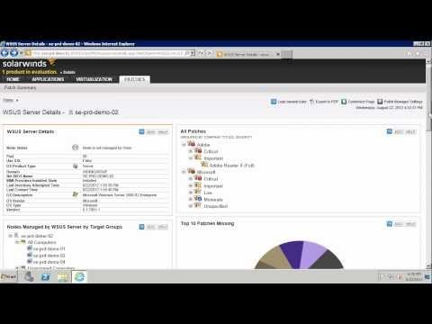
SolarWinds Patch Manager Guided Tour (Tice, 2012):

Slide 12
Patch manager advantages
Manage many machines simultaneously
Supports OS and third party application patches
Reduce effort installing updates for each machine
Ability to test patches with deployment groups
Reporting allows admin/s to identify critical, non-critical, and not applicable patches
Minimize time between patch release and patch install
Minimize window of opportunity for attack

Slide 13
Passwords

Slide 14
Password protection
Blue Ink’s computers automatically log into the user “green” account without authentication
The screensaver is also not password protected
This would allow an attacker to gain access to Blue Ink’s computers and network resources by simply
Turning on the computer
Use the computer while the victim was not at his/her desk

Slide 15
Recommend: Active Directory security policies
Enable and configure Active Directory on Blue Ink’s Windows 20xx Server
Configure domain level password policy, such that a user must have a password (Microsoft, 2005a)
Selected password must meet password policy requirements (Microsoft, 2012)
Configure account lockout policy after 3 failed attempts
Enforce screensaver lock through Group Policy (Microsoft n.d.-a)

Slide 16
Active Directory advantages
Users must authenticate to an Active Directory domain controller in order to log in to their account and use a Blue Ink computer
Enforce password policy
Assign and enforce security policies for users and computers
Enforce screensaver lock
Account lockout after 3 failed attempts
Mitigate brute-force attacks

Slide 17
Choosing passwords
Simple passwords very easy to brute-force or dictionary attack
If password too complicated
Too hard to remember
May lead to users writing down their password in plaintext (physical or digital)

Slide 18
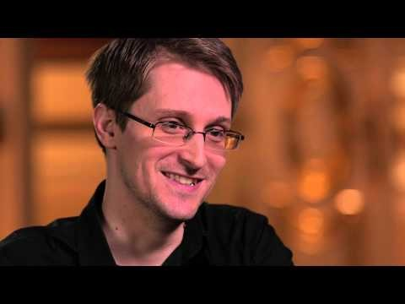
Recommend: Passphrases
Oliver & Snowden (2015) discuss how to select a strong but memorable passphrase

Slide 19
Recommend: Password policy
Goodin (2014) reports that Stanford University’s IT department has implemented an effective password policy
As the length of characters in a password increase, the requirements for specific characters decrease
Promotes longer but more memorable passphrases rather than short complicated passwords
Recommend Blue Ink adopt a similar password policy
Minimize risk that a user will write password down on paper or save in plaintext

Slide 20
User practices

Slide 21
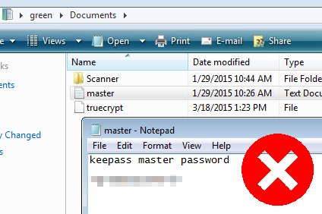
Passwords in plaintext
A password was saved in plaintext in a user’s “My Documents” folder
An attacker could easily read password if gained access to computer

Slide 22
Recommend: Delete/destroy passwords in plaintext
Securely delete files containing passwords in plaintext
Include *.pdf, *.xls, *.ppt, etc. Not just *.txt files
Destroy any passwords written down on paper
ie. Sticky notes
Recent disclosure of French TV social network passwords on YouTube via sticky notes behind a reporter during an interview (Machkovech, 2015)
Attackers can easily retrieve passwords on paper too
Use of memorable passphrases will mitigate need for writing passwords down

Slide 23
mIRC Internet Relay Chat
Internet Relay Chat (IRC) share similar risks of malware propagation as email
Attackers may use social engineering to
Convince victims to view links to malicious web pages or files
Convince victims to open malicious files sent directly through IRCs file-sharing protocol
Removal of mIRC will mitigate these risks

Slide 24
User rights

Slide 25
Administrator rights
Normal employee users such as “green” given admin rights
Admin rights allow a user to
Install/uninstall software/drivers
Make critical system wide changes to settings
ie. Add/modify/delete other users
If a user with admin rights is attacked, the attacker may also inherit these privileges

Slide 26
Recommend: Active Directory user rights policy
Configure Active Directory user groups
Assign appropriate user rights to groups (Microsoft, 2005b)
ie. Reserve admin rights for IT support staff only
Standard users will need administrator permission to
Make critical system changes
Mitigate possible changes made by malware
Un/install applications/drivers
Mitigate possible malware propagation
Attacker may only inherit Standard user rights

Slide 27
User Account Control (UAC)
UAC has been disabled in Blue Ink’s computers
UAC assists in protecting the computer by:
Preventing unauthorized changes by a program to the computer (Microsoft, n.d.-b)
Requires authorization by an administrator to commit changes

Slide 28
Recommendation: Active Directory group policy
Configure Active Directory user groups to enforce UAC (Microsoft, 2007)
Critical system changes made by software or users will now require permission by an administrator
Mitigate possible changes made by malware
Mitigate possible malware propagation

Slide 29
Anti-virus and network security

Slide 30
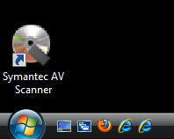
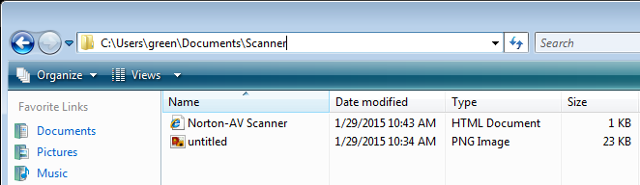
Fake anti-virus
Fake anti-virus found
Origin unknown
Potentially installed through malware propagation
Delete desktop shortcut and supporting files immediately

Slide 31
Recommend: Kaspersky End Point Security Select
Enterprise anti-malware/virus application
Supports multiple platforms: Windows, OS X, Linux
Monitors/detects and stops exploits
Supports Adobe Reader, Microsoft Office, Internet Explorer, Java etc.
Provides firewall functions, can monitor Internet use
Protects mobile devices

Slide 32
Recommend: KFSensor honeypot system
Windows based honeypot Intrusion Detection System (IDS) designed for corporate environments
Acts as a decoy to attract attackers in the event the network is compromised
Simulates vulnerable FTP, SMB, POP3, HTTP, Telnet, SMTP and SOCKS
Diverts attacks away from critical areas of network
Identifies attack signatures and logs events

Slide 33
Summary

Slide 34
Patch management
Use proactive patch management strategy
Mitigate vulnerabilities in software
Recommend SolarWinds Patch Manager 2.1
Manage patching in large computer network
Passwords
Configure users/groups with Active Directory
Enforce passwords, password policy, screensaver lock, and account lockout after failed attempts
Use passphrases for password policies
Prevent users from writing passwords down

Slide 35
User practices
Do not store passwords in plaintext files or handwritten notes
Remove mIRC to prevent malware propagation
User rights
Configure Active Directory user groups with appropriate user rights
Reserve admin rights for IT support staff
Enforce UAC through Active Directory group policy

Slide 36
Anti-virus and network security
Remove fake anti-virus
Recommend Kaspersky End Point Security Select
Recommend KFSensor honeypot system
Simulates vulnerable services to entice attacker
Diverts attackers away from critical systems in the event an attacker compromises network
Logs events

Slide 37
References
Baker, W. H., Hylender, C. D., & Valentine, J. A. (2008). 2008 Data Breach Investigations Report, 1–29.
Goodin, D. (2014). Stanford’s password policy shuns one-size-fits-all security | Ars Technica. Ars Technica. Retrieved April 30, 2015, from http://arstechnica.com/security/2014/04/25/stanfords-password-policy-shuns-one-size-fits-all-security/
Machkovech, S. (2015). Hacked French network exposed its own passwords during TV interview | Ars Technica. Ars Technica. Retrieved May 6, 2015, from http://arstechnica.com/security/2015/04/09/hacked-french-network-exposed-its-own-passwords-during-tv-interview/
Microsoft. (2005a). Apply or modify password policy: Logon and Authentication. Retrieved May 14, 2015, from https://technet.microsoft.com/en-au/library/cc781633(v=ws.10).aspx?f=255&MSPPError=-2147217396#BKMK_3
Microsoft. (2005b). Assign user rights to a group in Active Directory: Active Directory. Retrieved May 14, 2015, from https://technet.microsoft.com/en-au/library/cc786658(v=ws.10).aspx
Microsoft. (2007). Configure UAC settings via policy - Microsoft Reduce Customer Effort Center - Site Home - TechNet Blogs. Retrieved May 14, 2015, from http://blogs.technet.com/b/asiasupp/archive/2007/02/08/configure-uac-settings-via-policy.aspx
Microsoft. (2012). Password must meet complexity requirements. Retrieved May 14, 2015, from https://technet.microsoft.com/en-us/library/hh994562(v=ws.10).aspx
Microsoft. (n.d.-a). Screen Saver timeout. Retrieved May 14, 2015, from https://technet.microsoft.com/en-us/library/cc961876.aspx
Microsoft. (n.d.-b). What is User Account Control? - Windows Help. Retrieved March 14, 2015, from http://windows.microsoft.com/en-au/windows/what-is-user-account-control#1TC=windows-vista
O’Connor, E. (2008). BigAdmin Feature Article: Patch Management Best Practices. Retrieved May 13, 2015, from http://www.oracle.com/technetwork/systems/articles/patch-management-jsp-135385.html
Oliver, J., & Snowden, E. [LastWeekTonight]. (2015, April 9). Last Week Tonight with John Oliver: Edward Snowden on Passwords. Retrieved May 6, 2015, from https://www.youtube.com/watch?v=yzGzB-yYKcc
Scarfone, K., & Souppaya, M. (2013). Guide to Enterprise Patch Management Technologies NIST Special Publication 800-40 Guide to Enterprise Patch Management Technologies. NIST. doi:10.6028/NIST.SP.800-40r3
Tice, K. [solarwindsinc]. (2012, September 12) Patch Manager Guided Tour. Retrieved May 14, 2015, from https://www.youtube.com/watch?v=-DldViUL1d0

